Slide 1
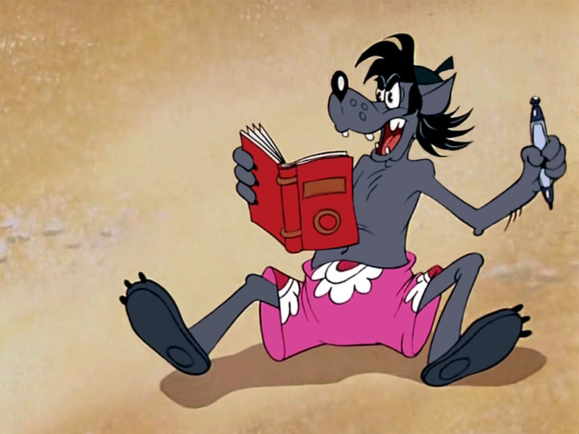
Little Red Ridding Hood
William-B G.U. Taka

Slide 2
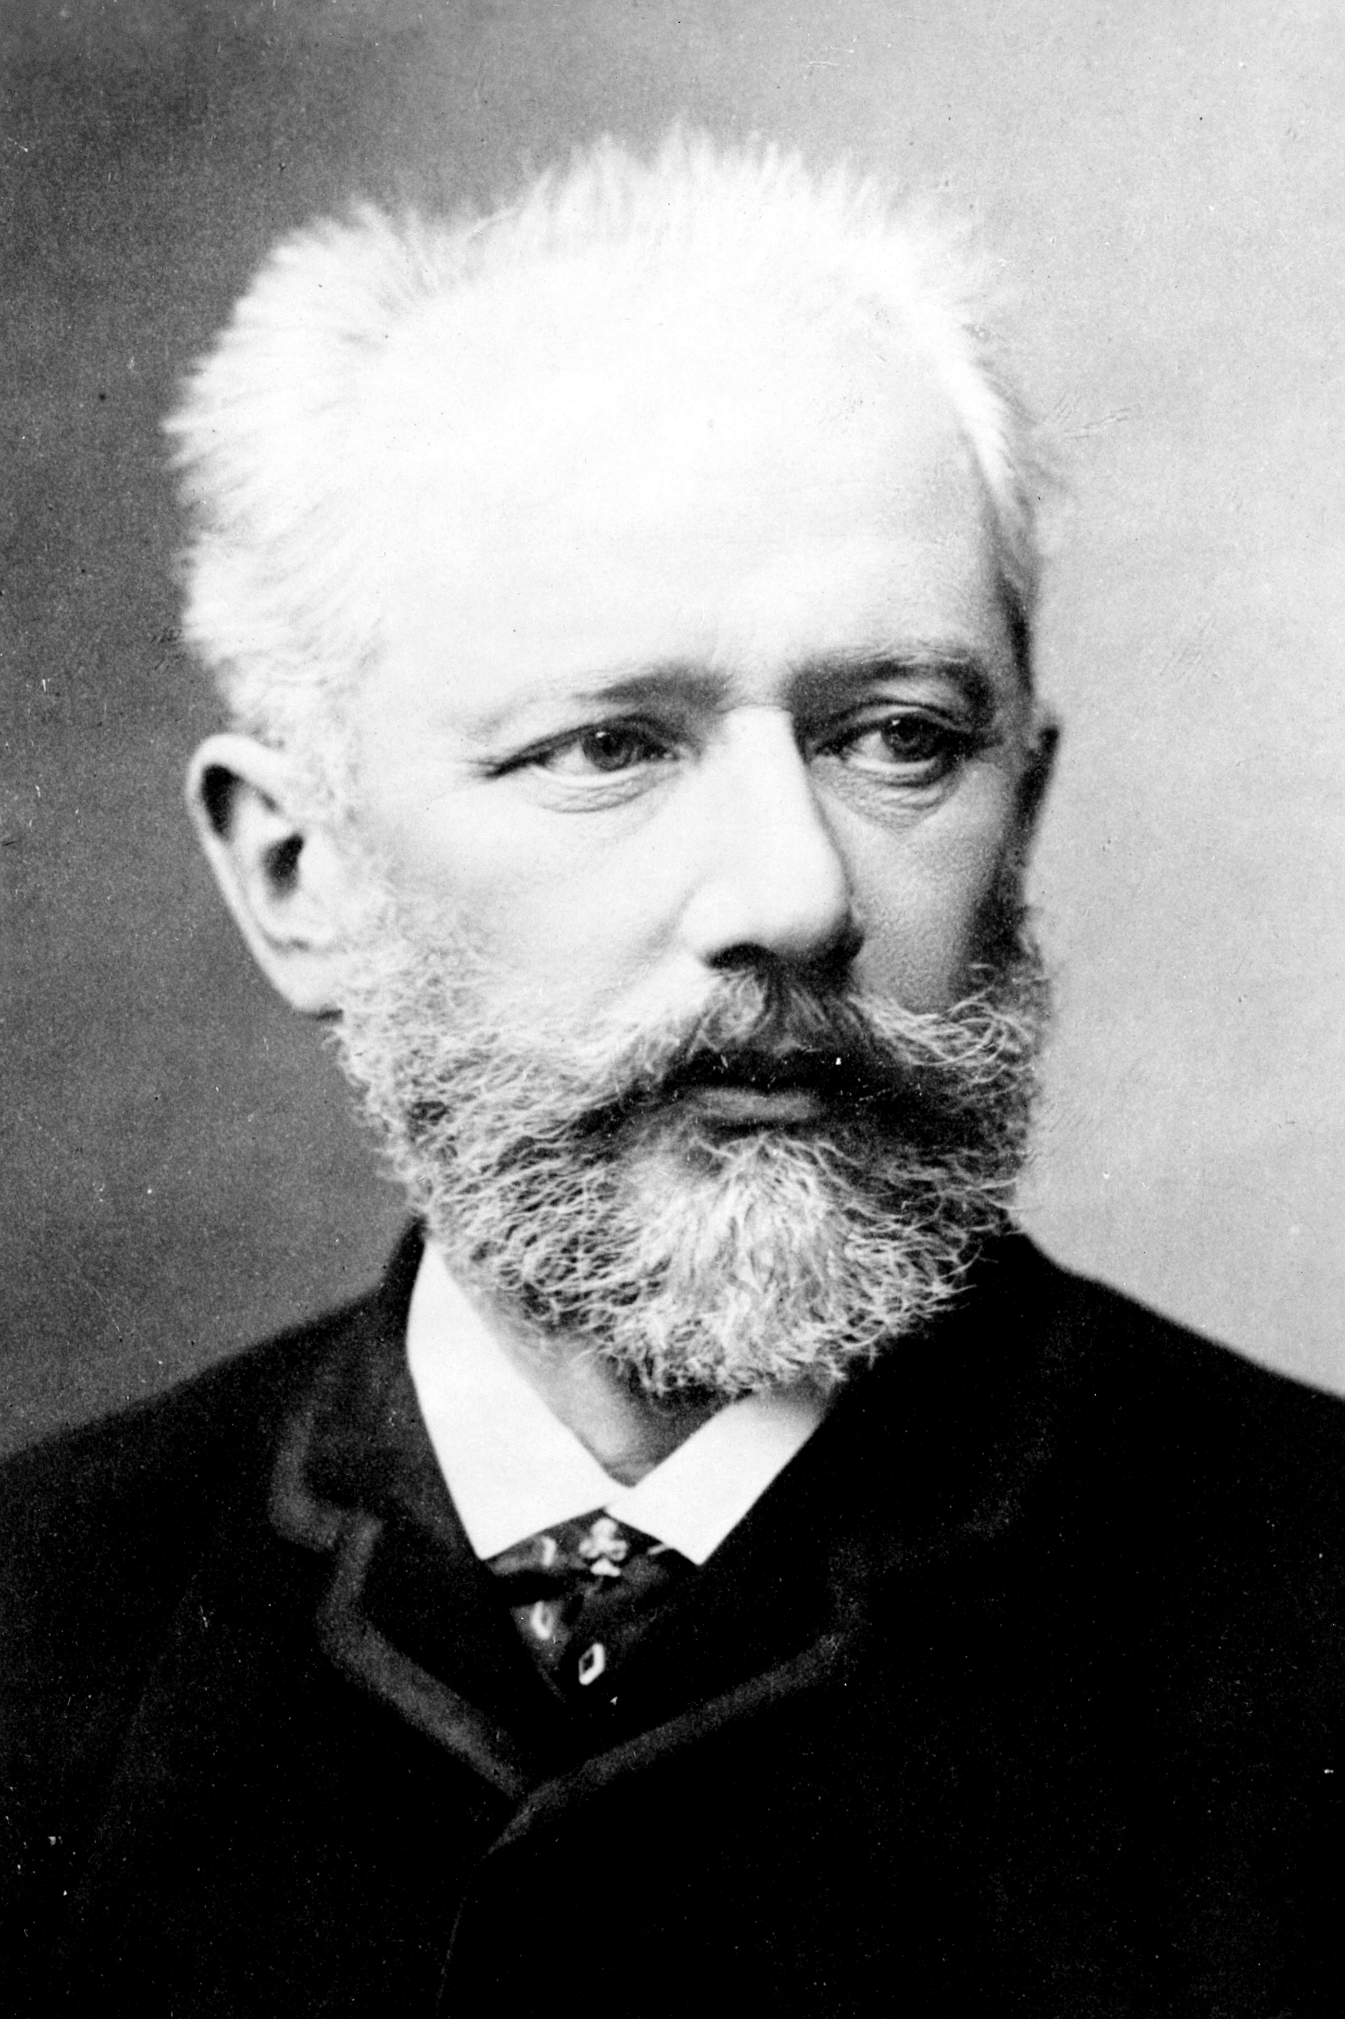
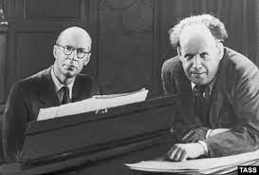
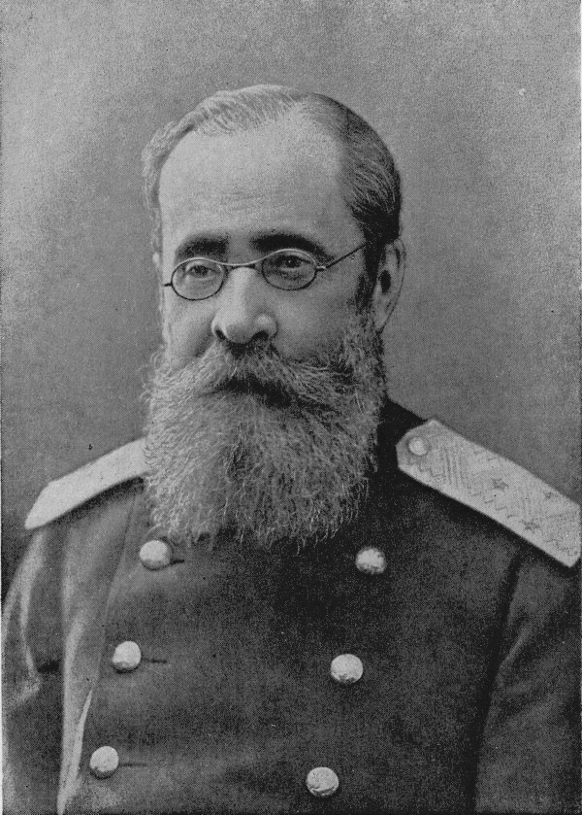
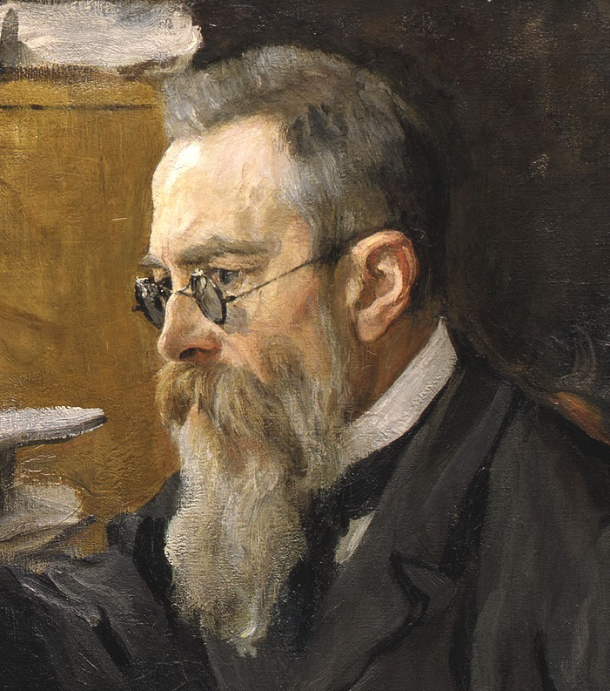
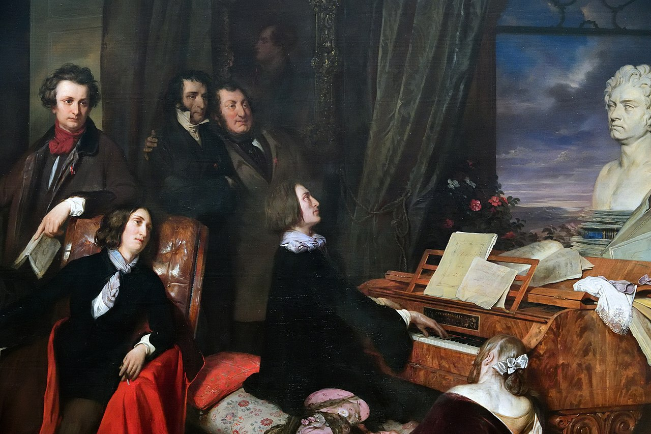
intro
About Etude
Individualistic Idealism
vs
Social Realism

Slide 3
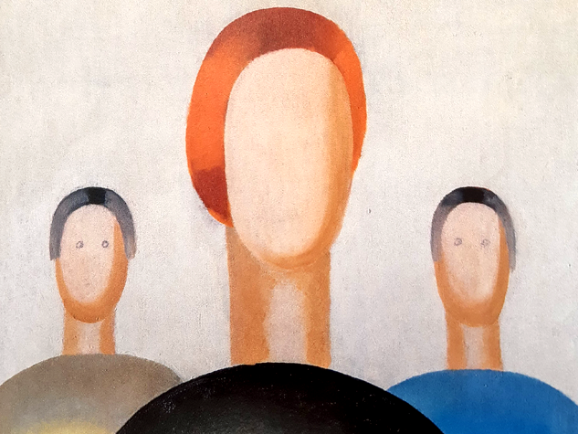
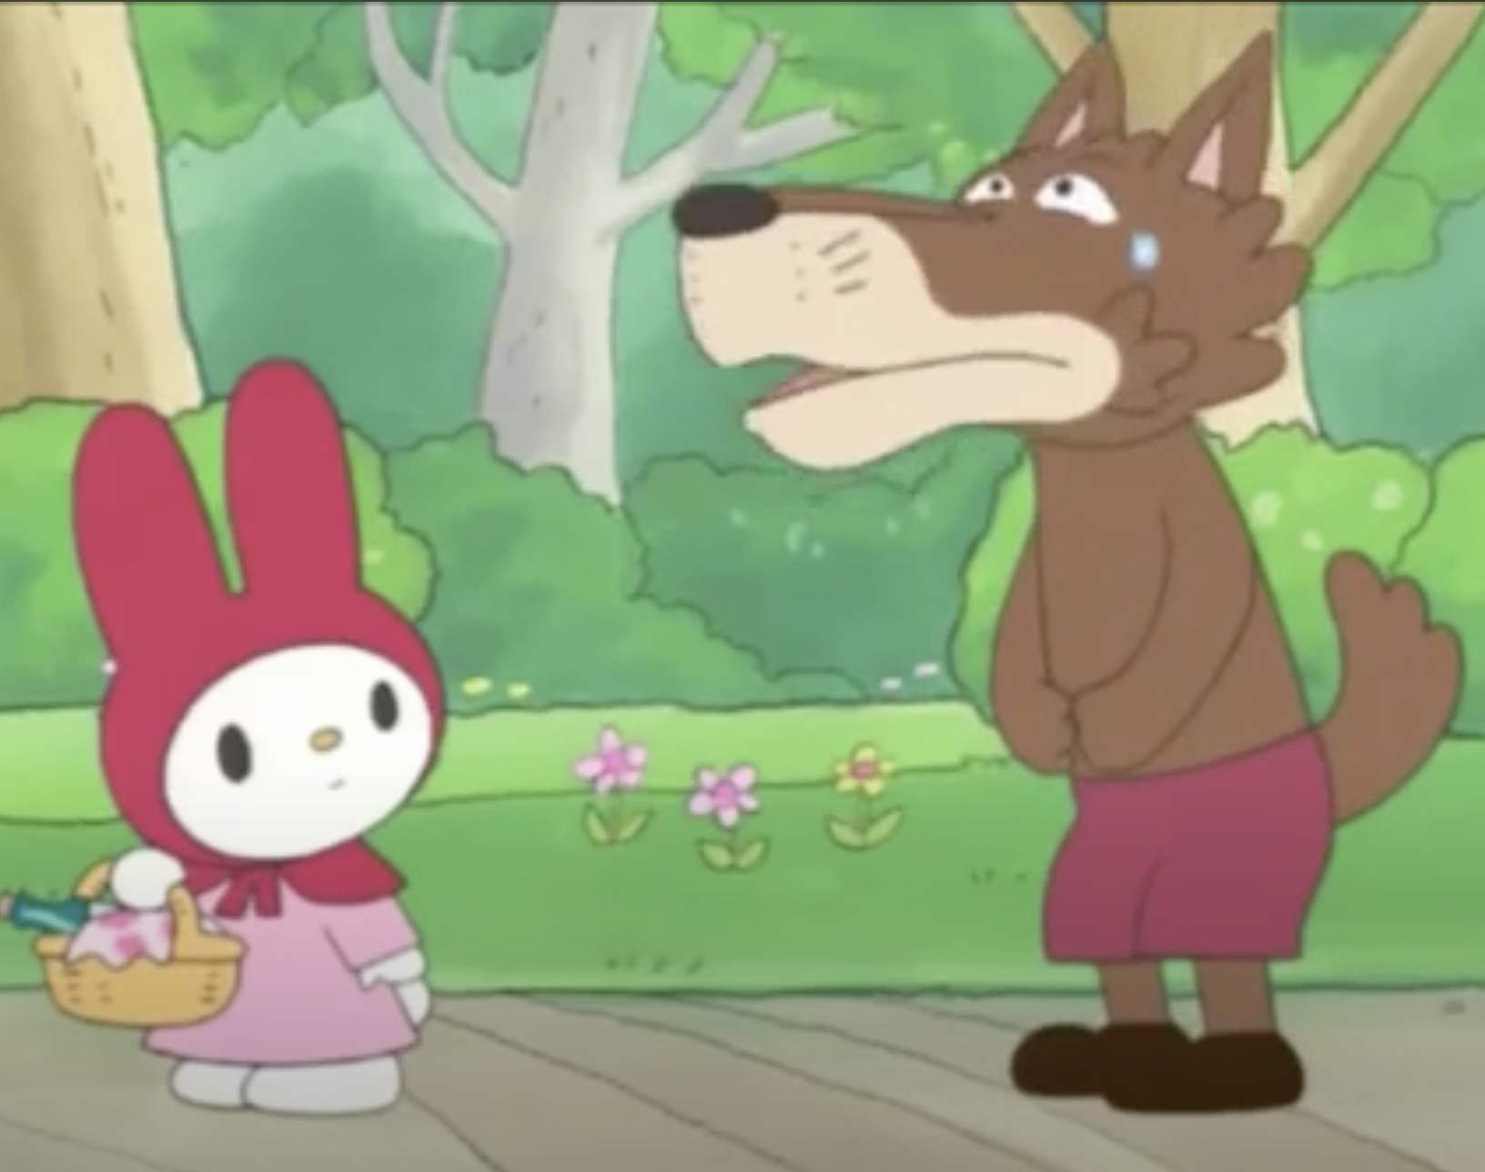
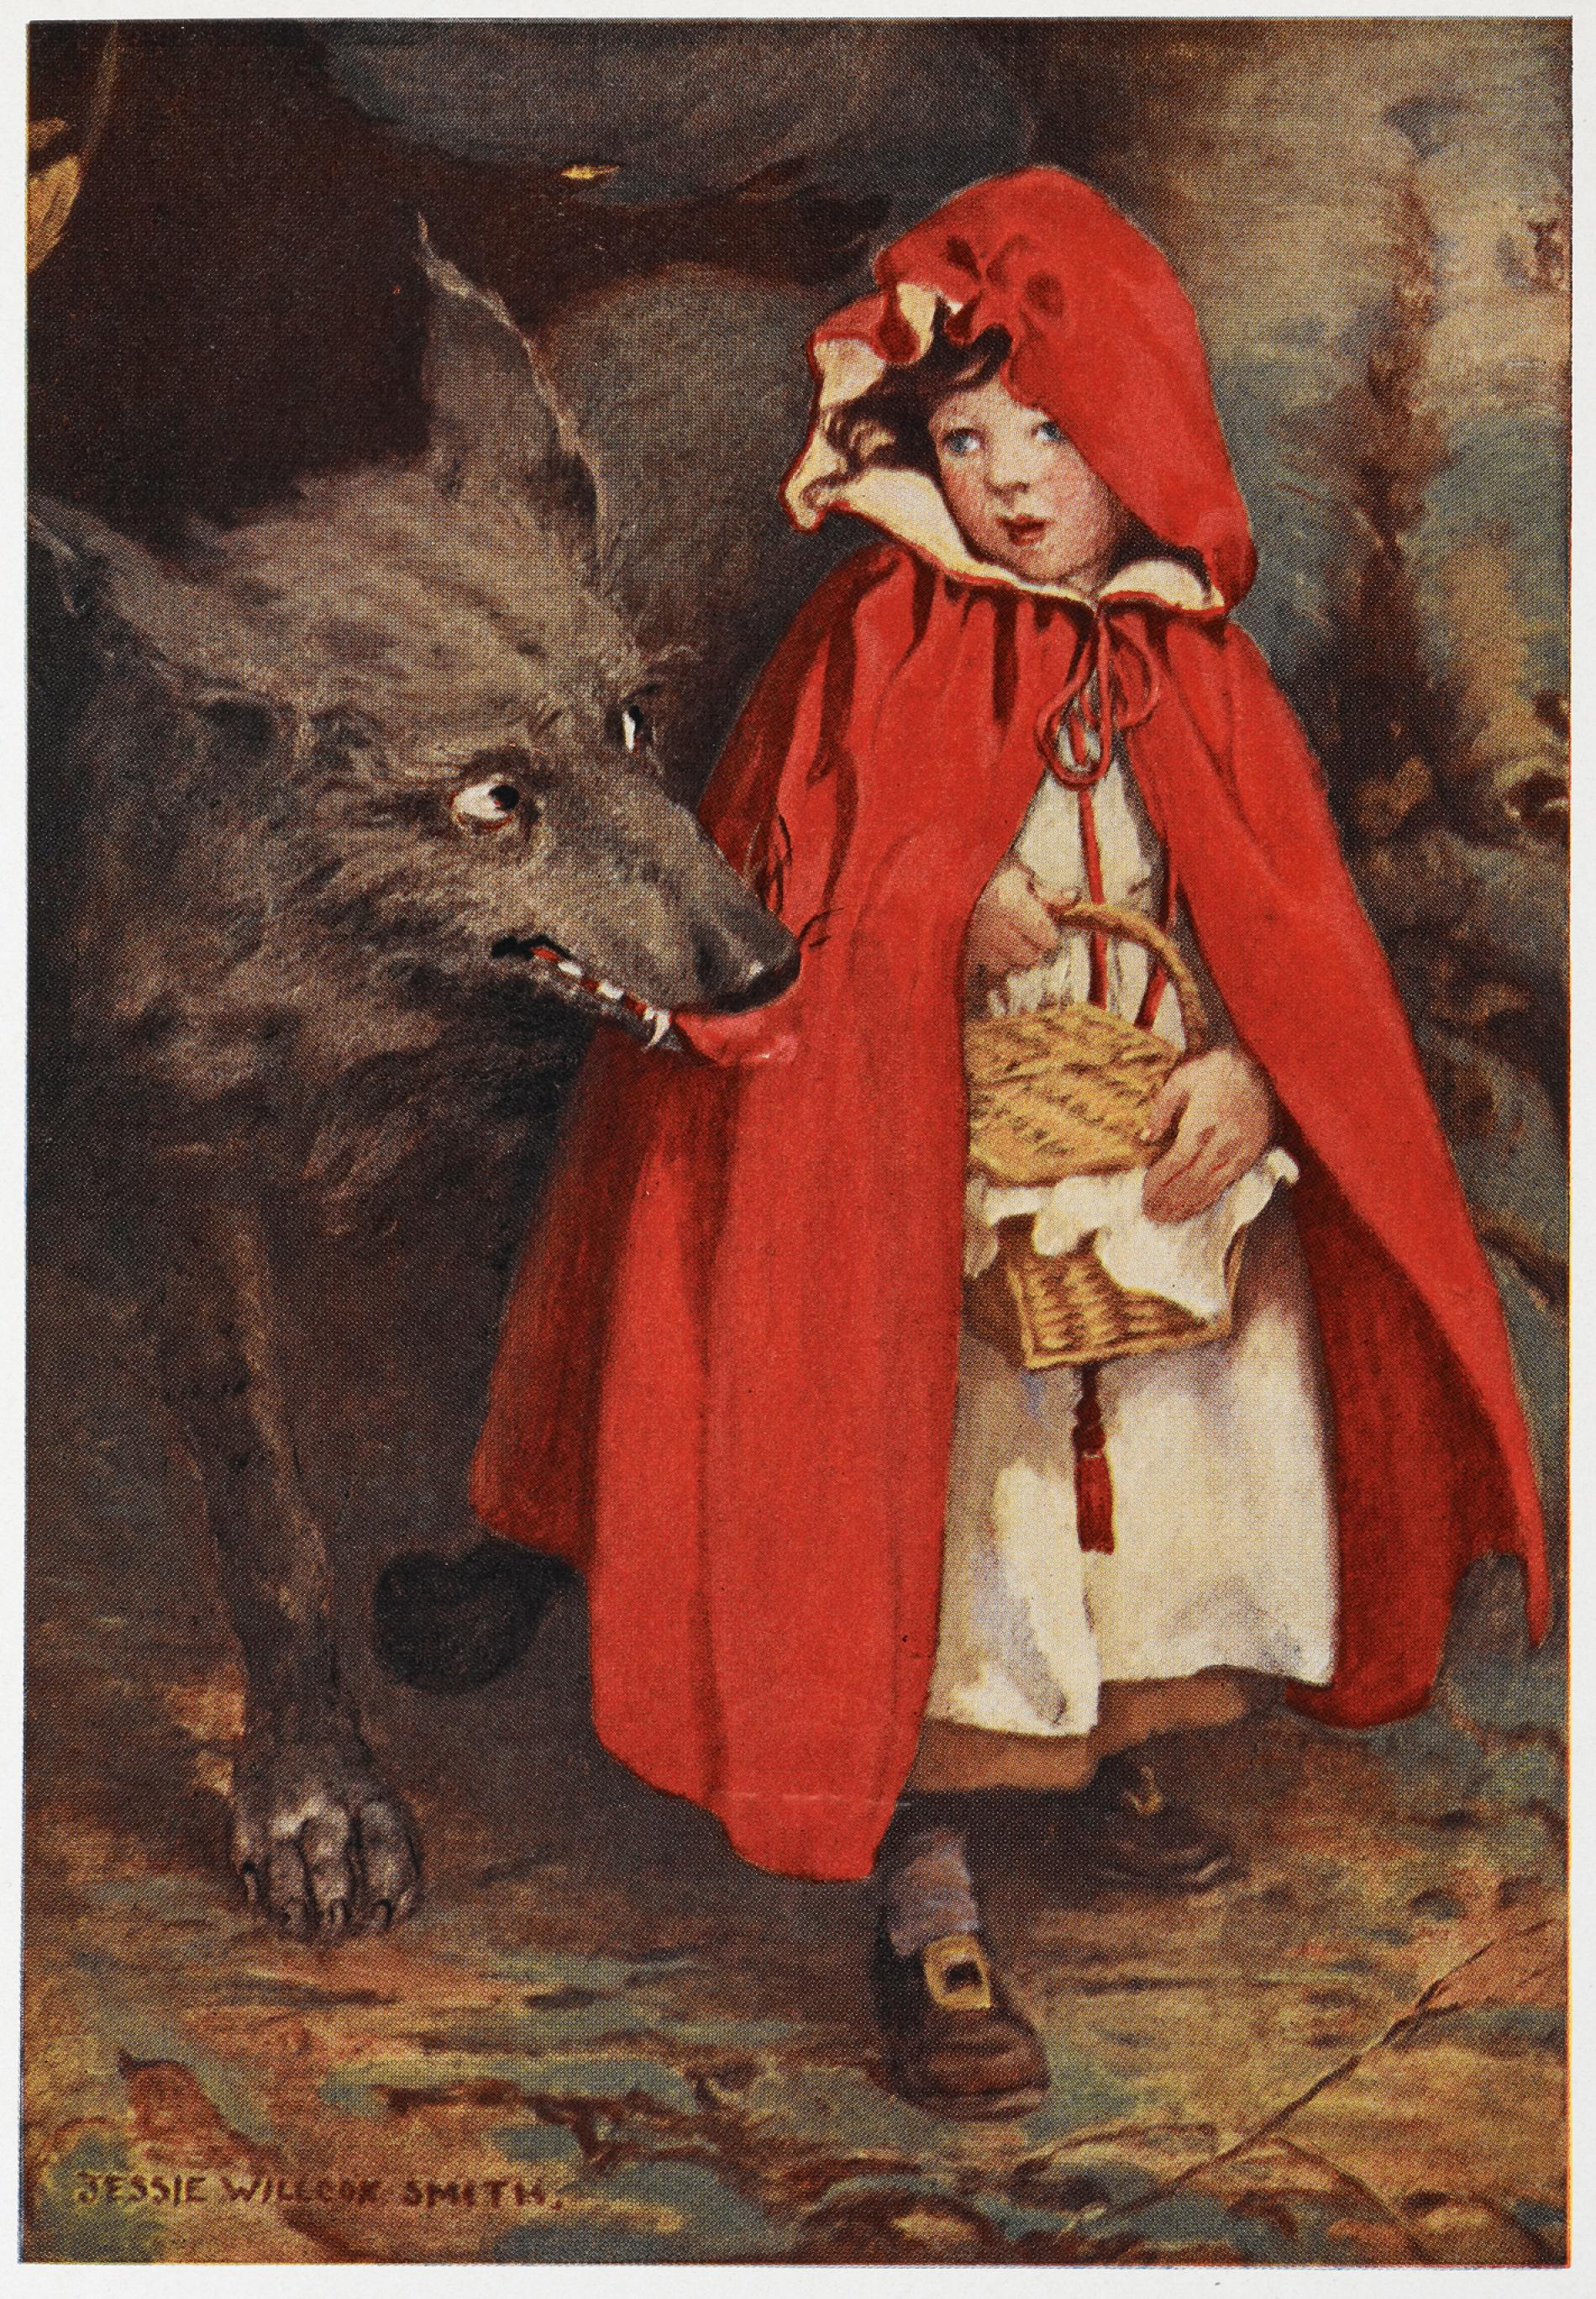
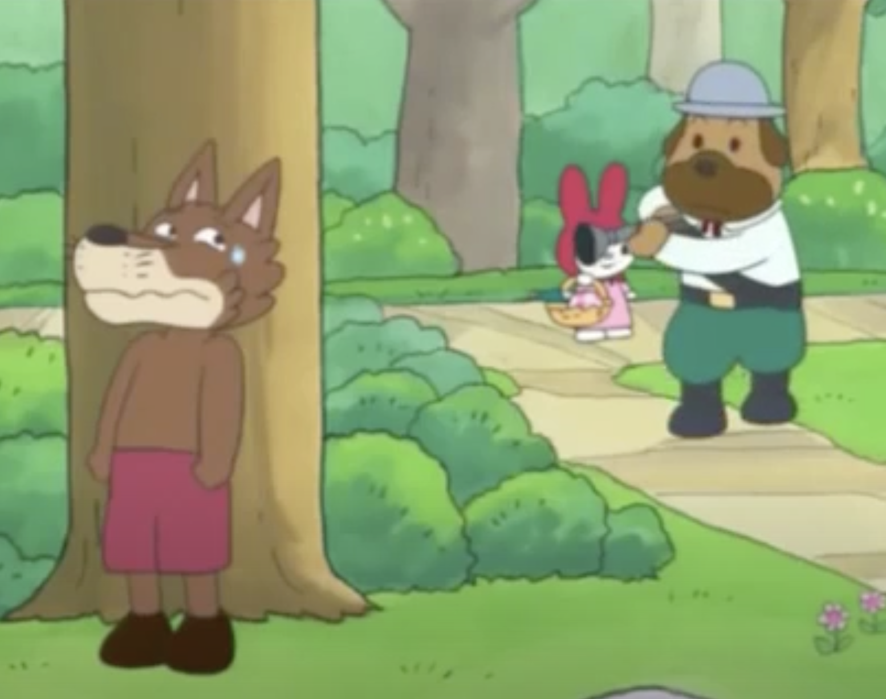
Little red ridding hood
The piece effectively using tension and release.
Works better than anti-depressants
Examplar based character
the idea of creating a rich store of memories from which one can later be mapped directly onto the practices of the Neapolitan conservatories(Gjerdingen 2007b 115)

Slide 4
Score

Slide 5
The three basic Neo-Riemannian operations: Relative, Parallel, and Leading-Tone Exchange
Dr Khannanov suggested that Rachmaninoff’s Etudes suggested a neo-Riemannian methods and a combination of contrasting harmonic style which suspends the effect of functional differentiation(According to Tatiana Bershadskaya1985)
two tonic harmonic are present one is weaker

Slide 6
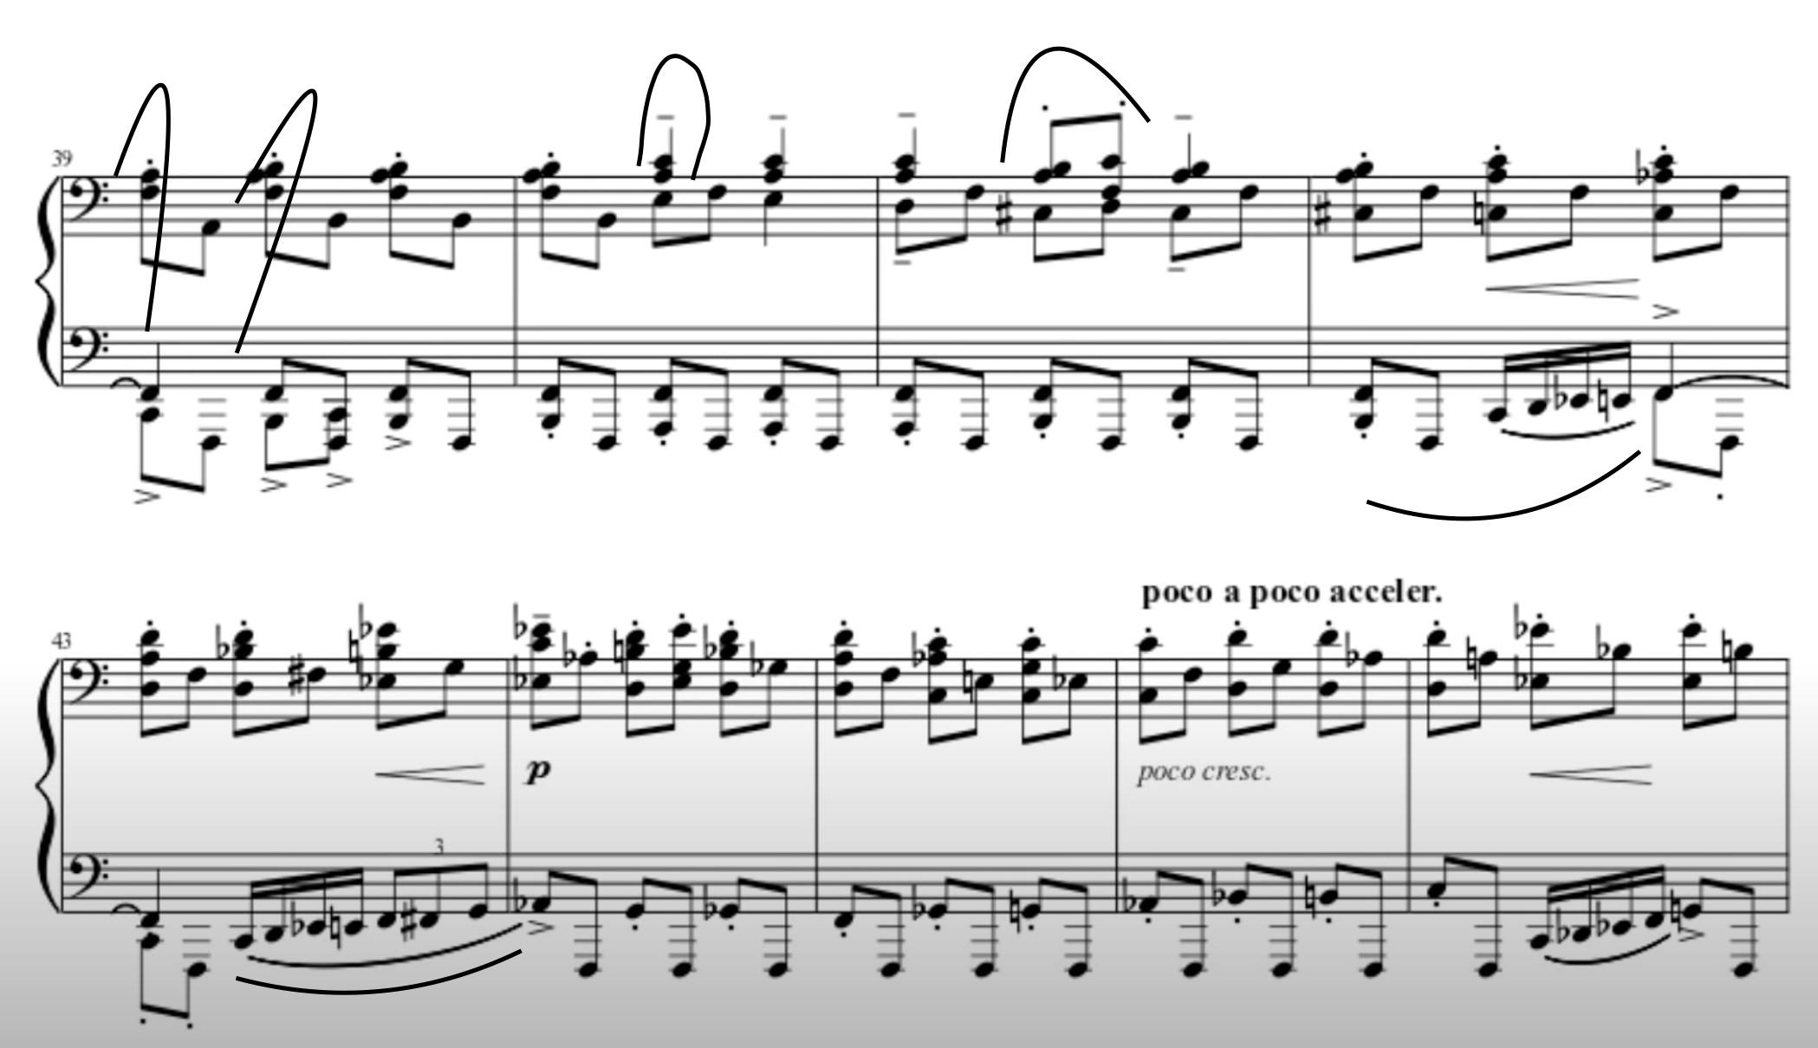
Just let him cook

Slide 7
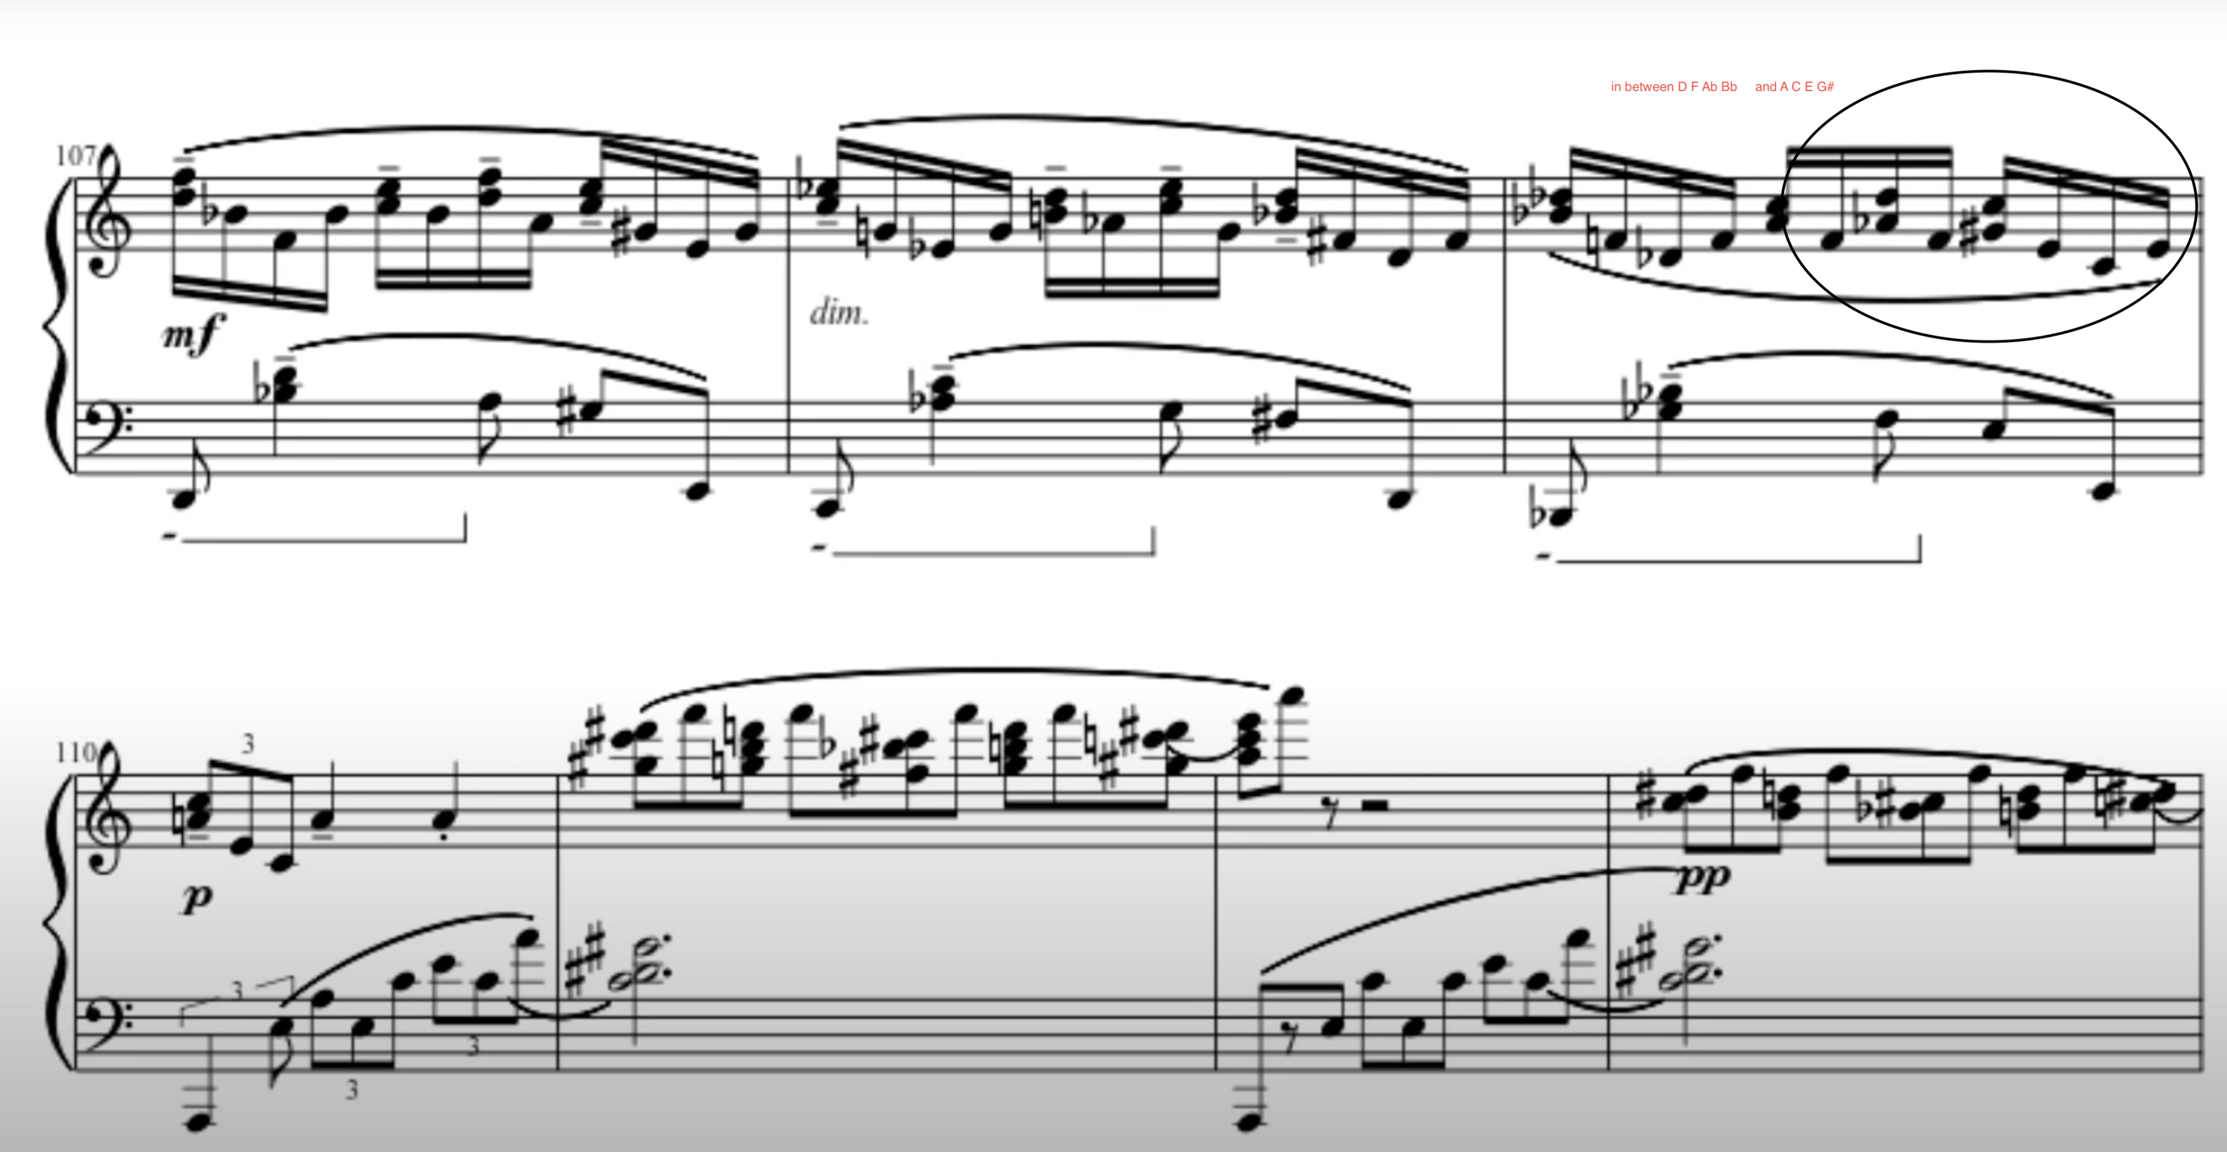
ambiguous ending
Tonic bypassing the dominant.
There are also II65 chords resolved into i64

